Slide 1
Participatory Design of Academic Libraries
International Conference KRE 11, Prague
September 10, 2011
Nancy Fried Foster
Director of Anthropological Research
River Campus Libraries, University of Rochester

Slide 2
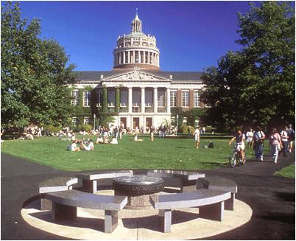
University of Rochester
Private College
Upstate New York
  4,608 Undergraduates
  2,900 Graduates
  1,258 Faculty
3 nearby campuses
  Medical Center
  Eastman School of Music
  River Campus

Slide 3
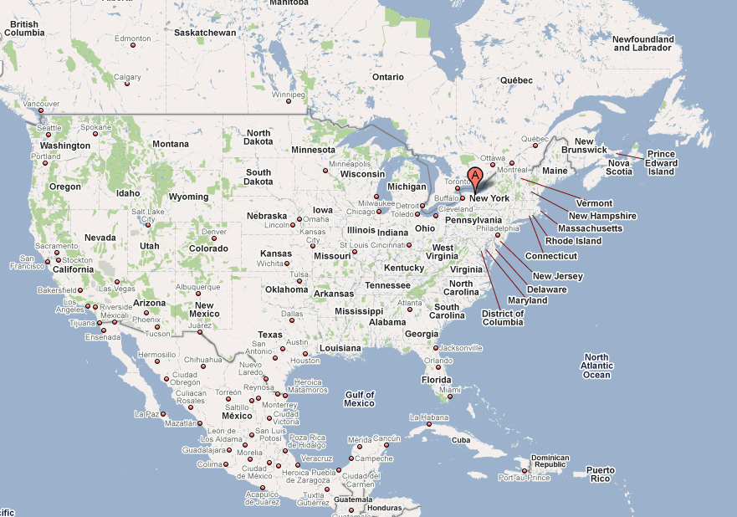

Slide 4
Photo of Cayuga Lake

Slide 5
Photo of sign near Cayuga Lake

Slide 6
Photo of classic design examples

Slide 7
Participatory Design

Slide 8
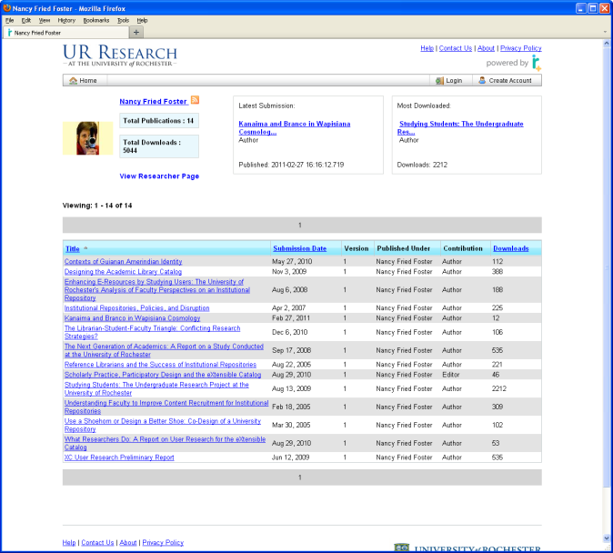

Slide 9
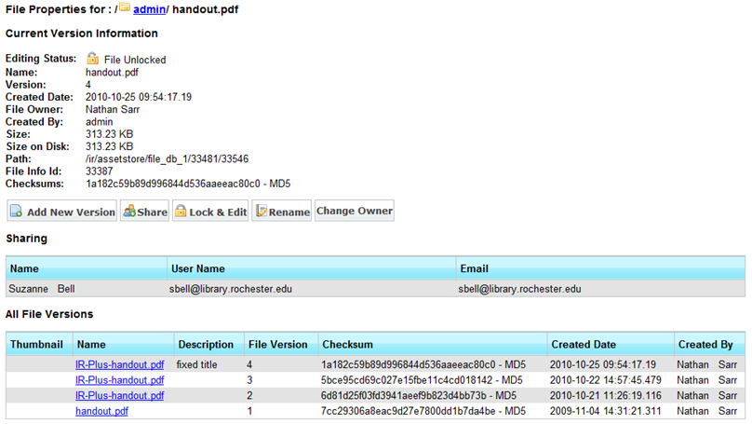

Slide 10
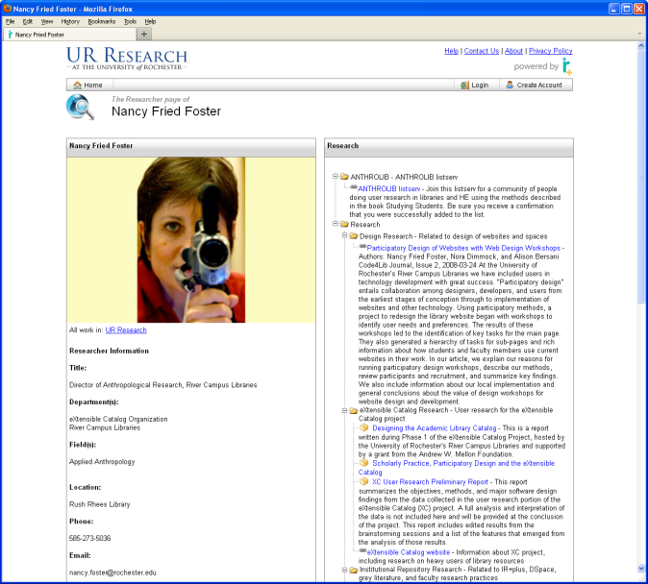

Slide 11
Photo of faculty being interviewed

Slide 12
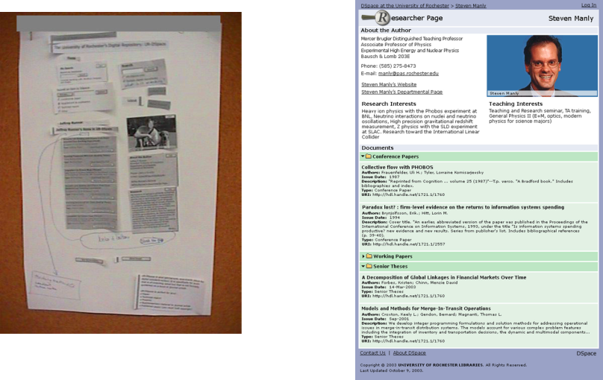

Slide 13

Select and refine solutions
Identify what they need to do and how they like to work
Recruit participants and refine objectives

Slide 14
Photo of faculty being interviewed

Slide 15
Photo of retrospective interview

Slide 16
Photo of map interview

Slide 17
Photo of dorm visit

Slide 18
Photo of design workshop artefact

Slide 19
What do they need?

Slide 20
What do they need to do?

Slide 21
Photo of nVivo software

Slide 22
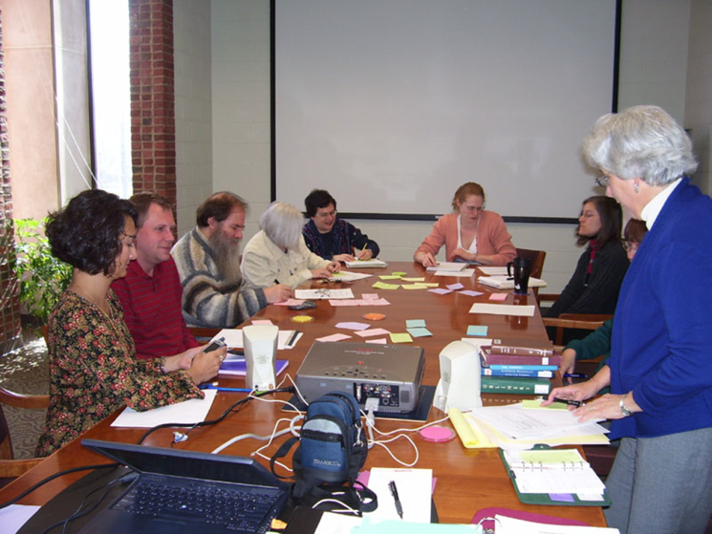

Slide 23
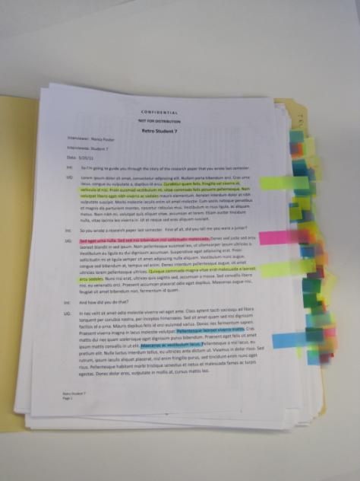

Slide 24
Photo of design workshop artefact

Slide 25
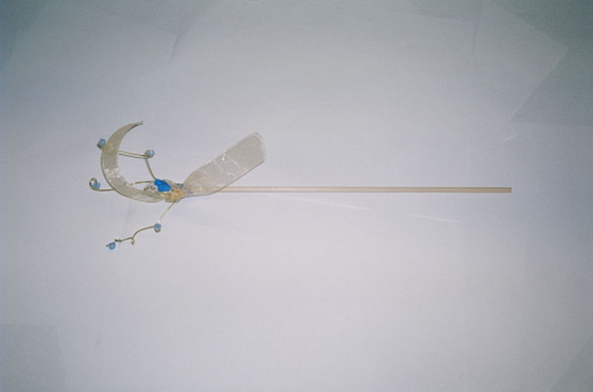

Slide 27
Criteria for assessing possible
XC features
Feasible, buildable
Closely related to core XC functionality
Meets known user needs
Could increase uptake of XC
Novel idea (either totally new or new to the library domain)

Slide 28
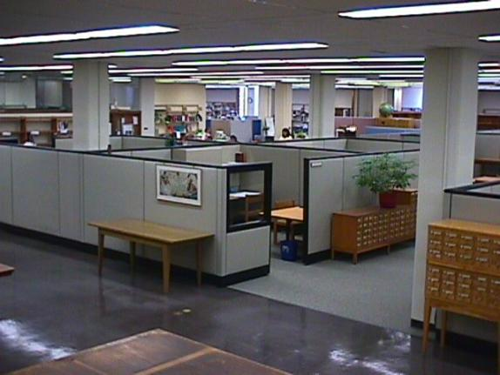

Slide 29
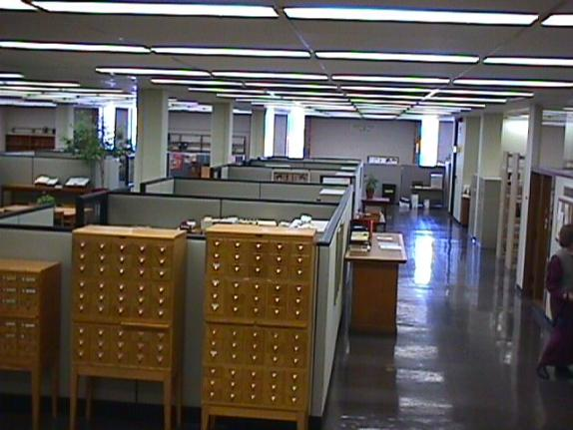

Slide 30
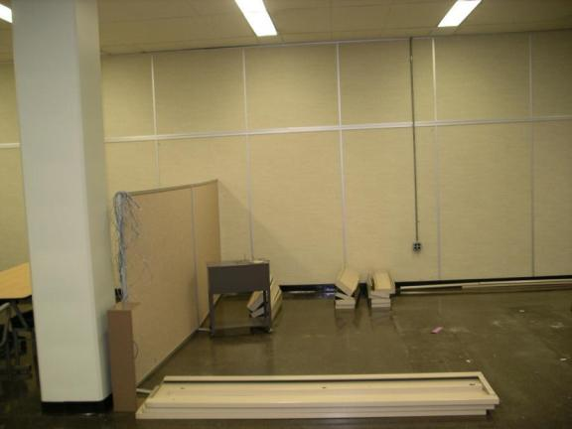

Slide 31
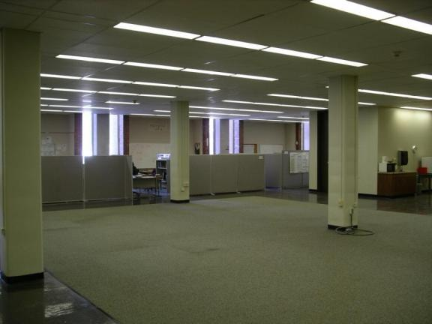

Slide 32
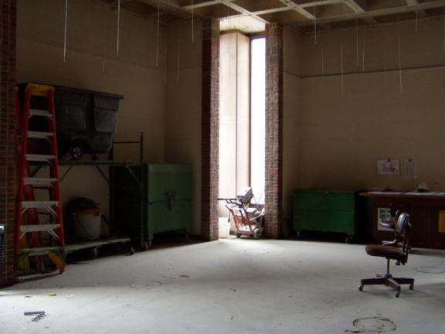

Slide 33
Photo of design workshop artefact

Slide 34
Photo of design workshop artefact

Slide 35
Photo of design workshop artefact

Slide 36
Photo of design workshop artefact

Slide 37
Major Recurring Themes
Students need to:
See within space and outside
Do different activities in same space
Feel secure and comfy (sit, slouch, lie down, eat, drink, spread books out, not get lost)
Use tools (plug in, get wireless, use a big screen, use a stapler)
Get help (very generic, all-purpose)

Slide 38
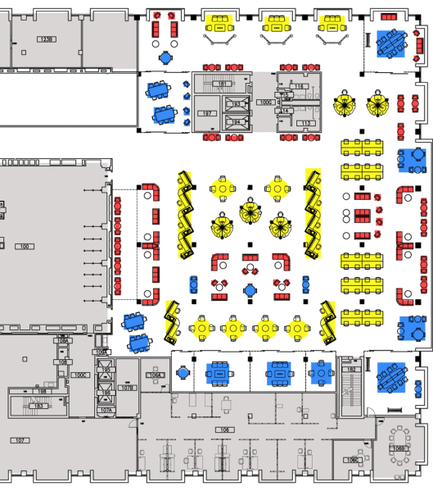

Slide 39
Photo of design workshop artefact

Slide 40
Photo of design workshop artefact

Slide 41
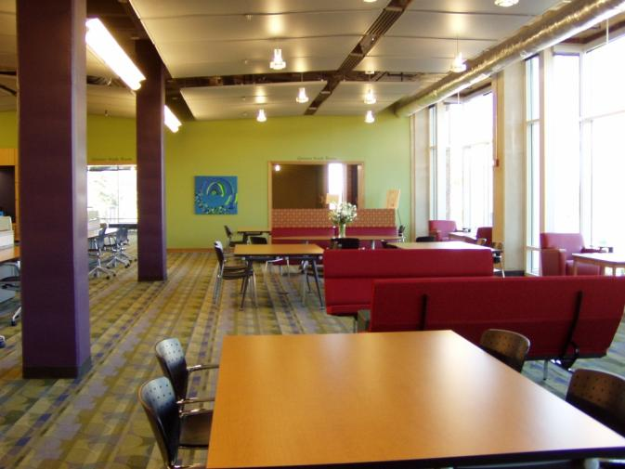

Slide 42
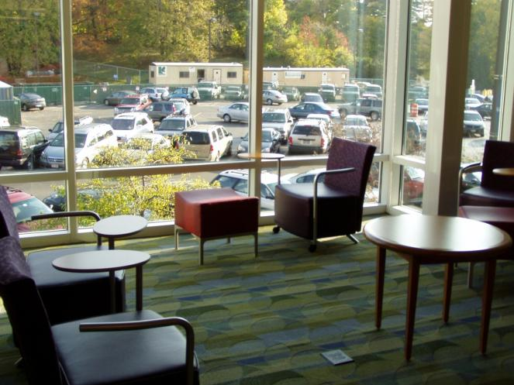

Slide 43
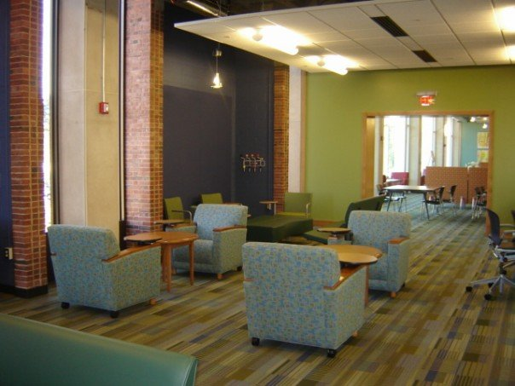

Slide 44
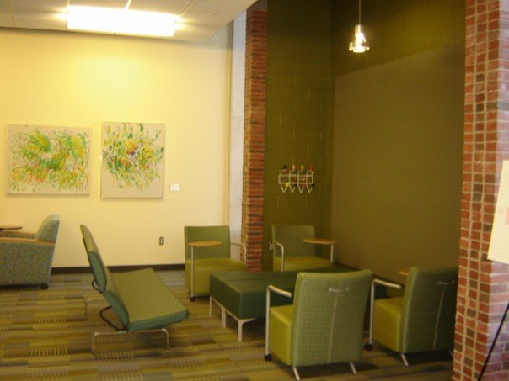

Slide 45
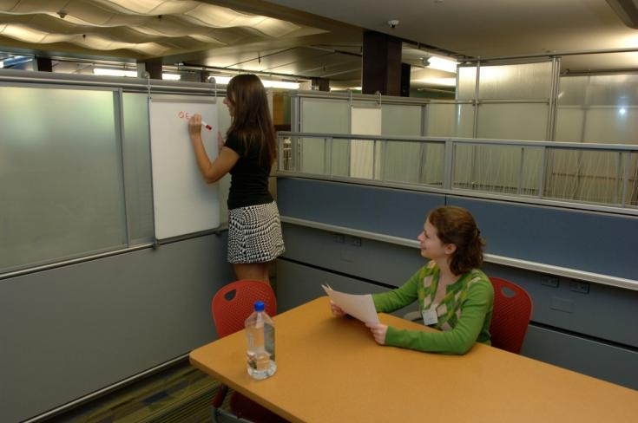

Slide 46



Slide 47
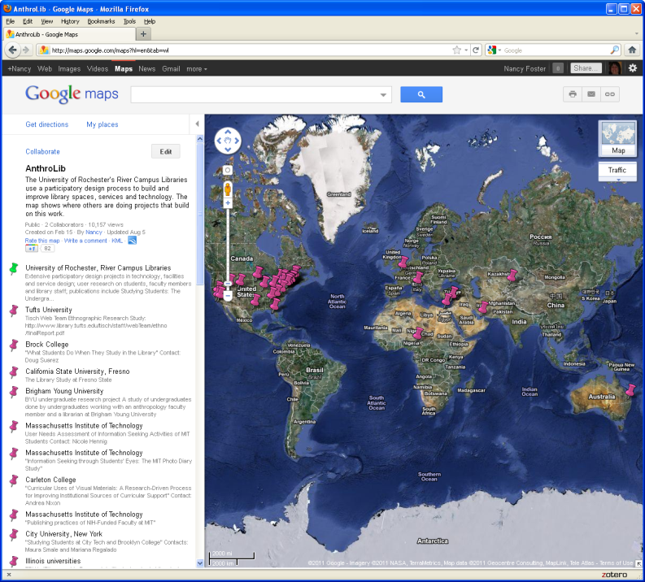

Slide 48
http://tinyurl.com/http-NancyFriedFoster-com
Nancy.Foster@Rochester.edu

