Slide 1
Crisis of scientific communication; fact or fiction?
R. Hanka
Univ. of Cambridge

Slide 2
Crisis, what crisis ?
Can we still cope with the rate new knowledge is growing?
Is it all really worth knowing?
Aren’t we keeping more and more to ourselves rather than sharing it?
Aren’t we loosing something we used to take for granted?.

Slide 3
Can we still cope with the rate new knowledge is growing?

Slide 4
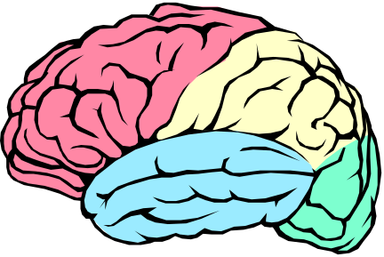

The problem
Different rate of expansion of:
our intellectual abilities
knowledge.

Slide 5
Human Intellectual Abilities
Over last 5 million years brain volume increased from 400cm³ to 1,400cm³.
Today 10¹¹ neurons and 10¹⁴ synapses.
Between n and n.(n-1)/2 connections.

Slide 6
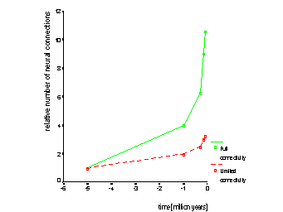
Brain capacity
n.(n-1)/2 connections
n connections
doubling every 1.5 to 3 million years.

Slide 7
Human knowledge
impossible to measure objectively
number of books in the Cambridge University Library used as a measure.

Slide 8
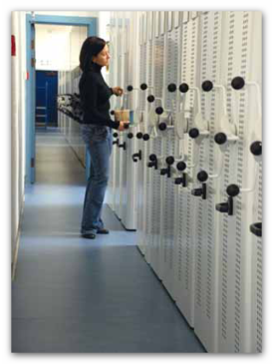
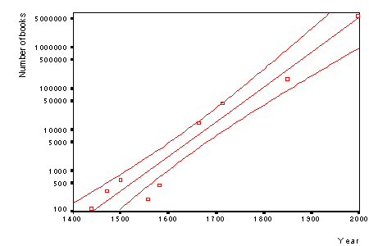
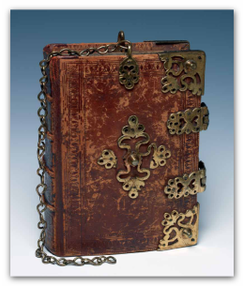
Books in the Cambridge University Library
doubling every 33 years !.

Slide 9
Expansion of knowledge and intellect
intellectual power
(doubling every 1.5 to 3 mill. Years)
Knowledge
(doubling every 33 years)
information overload.
time

Slide 10
Information Overload
15th century - polymath
18th century - scientist knew all there was to know in his field
20th century - specialisation
21st century - narrow specialisation.

Slide 11
Breadth of Knowledge
Depth of knowledge

Slide 12
Crisis of communication
Knowledge ≠ information
Overwhelmed with information
Difficult to find required information
Difficult to assess quality of the information found.

Slide 13
The Size of the Problem

Slide 14
Decision to pursue information depends on the
  Urgency.
  Expectation that a definitive answer can be found.
Notes:
(Gorman & Helfand 1995)

Slide 15
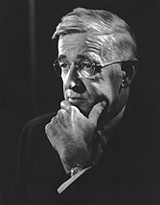
Vannevar Bush “As We May Think” (1945)
Personal Library (vertical books)
Trails (horizontal hypertext)
Updateable
With annotations.

Slide 16
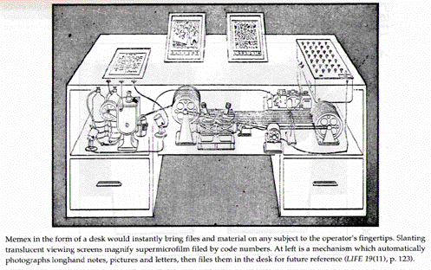
Memex

Slide 17
Is it all really worth knowing?

Slide 18
Internet
Information ‘pollution’
Haphazard collection of information
No structured navigation
Searches resulting in ‘64,000’ hits
Long access times
Is it all really reliable?.

Slide 19
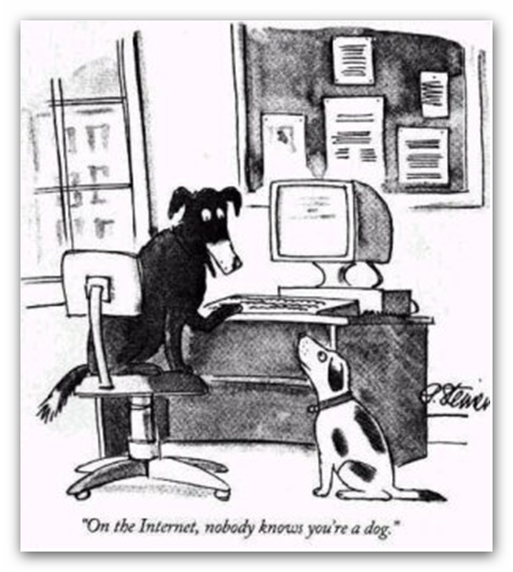

Slide 20
Books in the Cambridge University Library
Doubling every
33 years

Slide 21
New acquisitions

Slide 22
New acquisitions

Slide 23
Aren’t we keeping more and more to ourselves rather than sharing it?

Slide 24
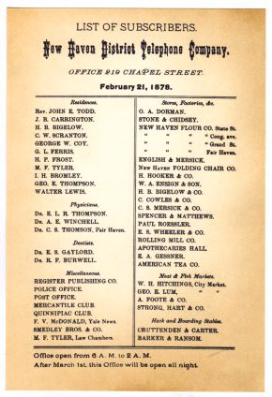
First telephone directory in the world.
New Haven 1878

Slide 25



Slide 26
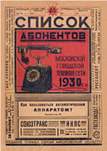
Last published Moscow telephone directory.
Subsequent editions deemed confidential and not generally available.

Slide 27
Current telephone directories are getting smaller: .
  Contain fewer and fewer of last year’s numbers
    Growing number of ex-directory entries
    Mobile phones replacing some lines.
  Mobile phones not listed.

Slide 28
Suppressing information
Political suppression of inconvenient evidence
  Napoleonic France (Humphry Davy)
  Stalin’s Russia or other communist states
Security aspects
  Data encoding, steganography
Computer software and Pharmaceutical industry
  Commercial reasons
    Complete suppression
    Time limited
    Overestimating benefits or underestimating risks

Slide 29
Protecting IP
Current emphasis on links between research and industry (transfer of technology).
  Need to protect intellectual property (IP)
  Delaying the publication until the IP rights are secured .
Recent trend
  In some areas a deliberate decision not to publicise, or even protect, latest advances in order to secure one’s commercial advantage.

Slide 30
Aren’t we loosing something we used to take for granted?

Slide 31
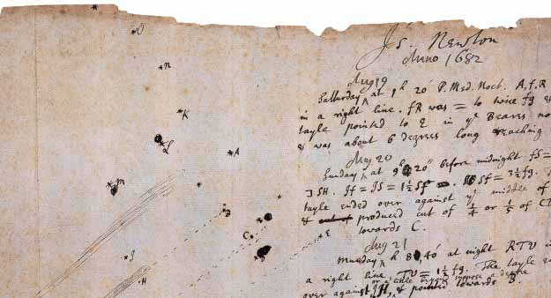
Newton’s record of observations of the comet of 1682, now known as Halley’s Comet, written on a scrap of paper perhaps torn from a letter.

Slide 32
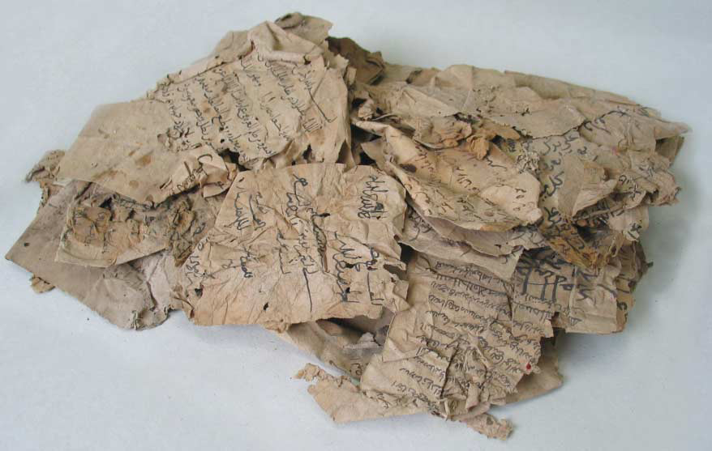
Arabic fragments still to be restored

Slide 33
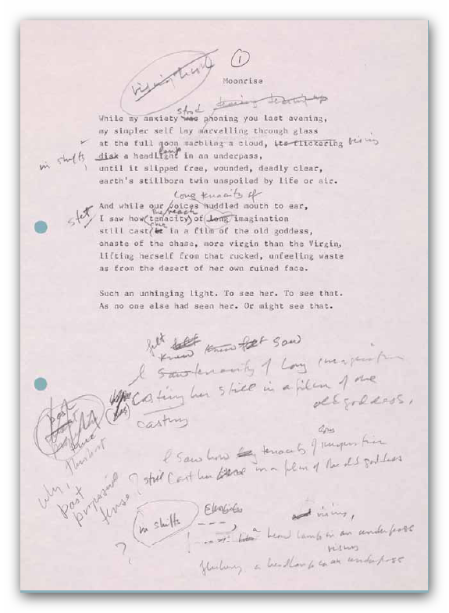
A draft of Anne Stevenson’s sonnet ‘Moonrise’, (from MS Add. 9451).

Slide 34
Emails are generally replacing informal means of communication e.g. letters to colleagues and friends.

Slide 35
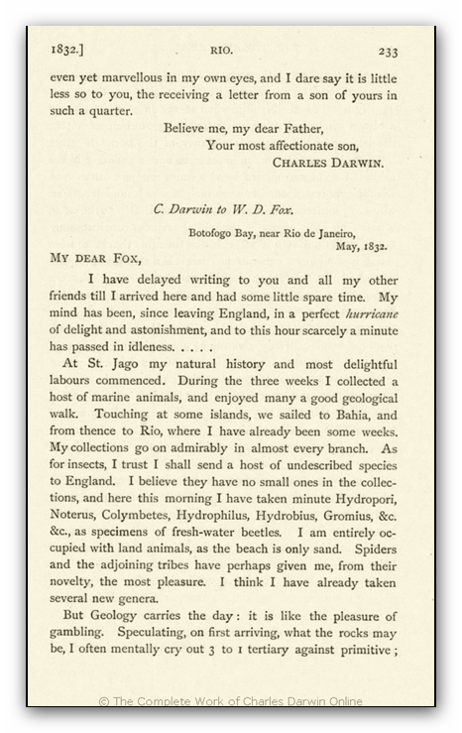
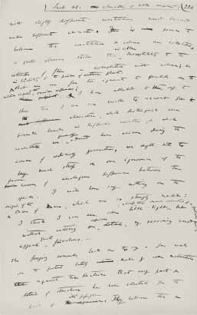
Darwin’s correspondence

Slide 36
Does anybody keep copies of his emails with colleagues?

Slide 37
New acquisitions

Slide 38
New acquisitions
60 400
electronic journals

Slide 39
New acquisitions

Slide 40
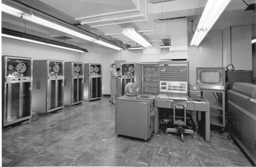
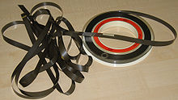
How secure, reliable and technologically up-to-date are the archives of older electronic documents and publications?.

Slide 41
Crisis of scientific communication;
fact or fiction
?

